Slide 1























AI-POWERED MULTI-DISEASE PREDICTION SYSTEM
Using Machine learning and Streamlit app
Done by, Ponnishree - 23D231 Srinivasan - 23D249

Slide 2

PROBLEM STATEMENT
Healthcare burden → Early detection of chronic diseases is critical.
Manual diagnosis is time-consuming and error-prone.
Lack of accessible AI tools for multiple diseases at once.

Slide 3
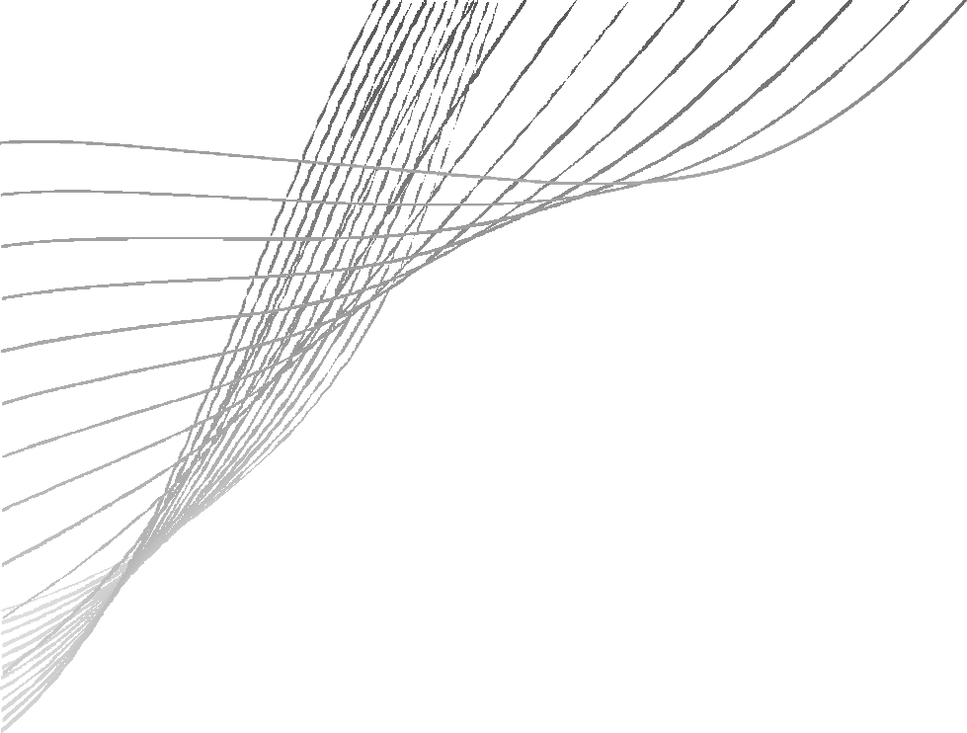


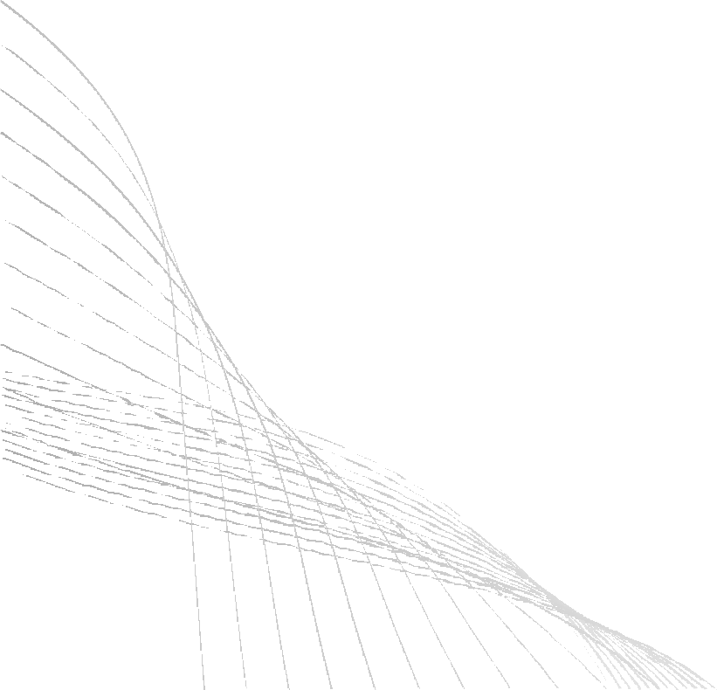
PROPOSED SOLUTION
A Streamlit-based AI App for predicting 7 diseases:
kidney disease
Hypertension
Stroke Cancer
liver disease
Diabetes
Heart disease
Interactive, user-friendly app with risk prediction gauge and PDF report generation.

Slide 4
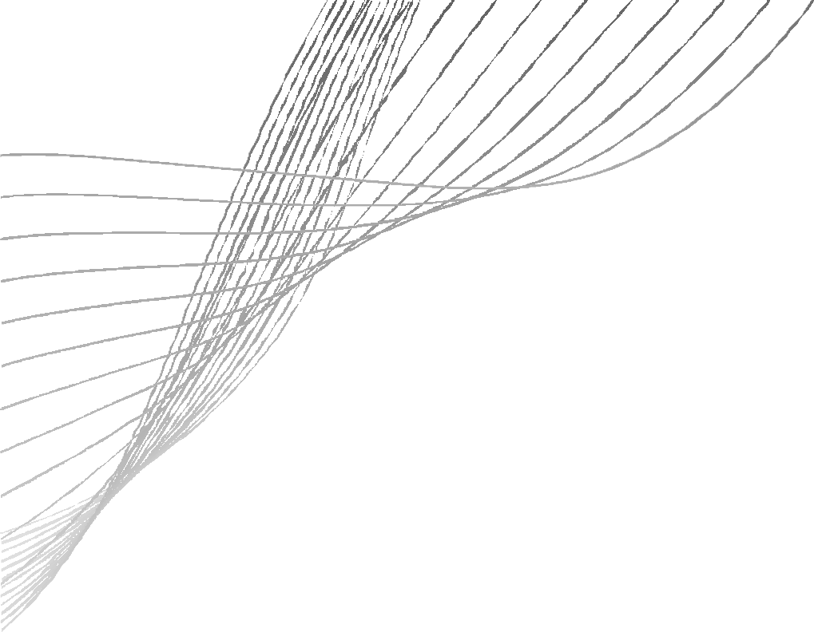



METHODOLOGY / PIPELINE
Preprocessing (cleaning, encoding, scaling)
Data Collection (7 disease datasets)
Model Training (ML algorithms)
Prediction & Visualization (gauge charts, risk)
Streamlit App (UI for user input)
Model Saving (.pkl files)

Slide 5
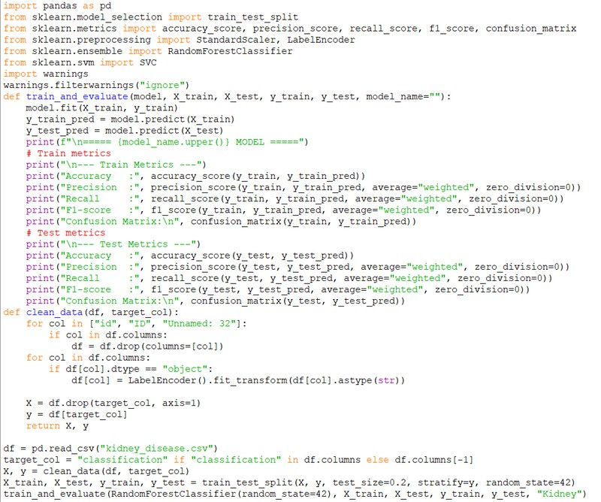
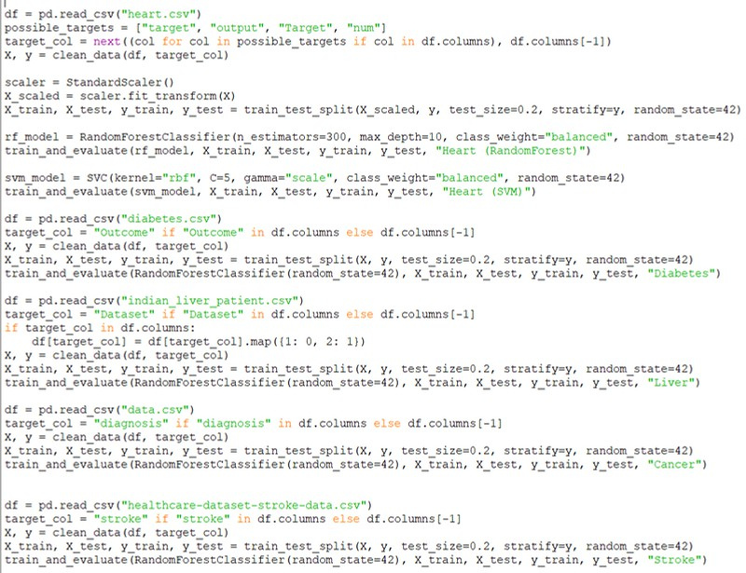
TRAIN AND TEST MODEL PERFORMANCE MEASURES

Slide 6
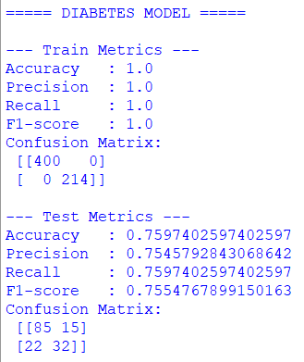
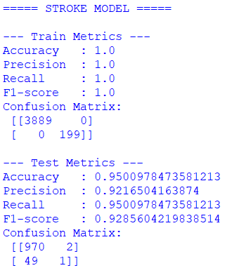
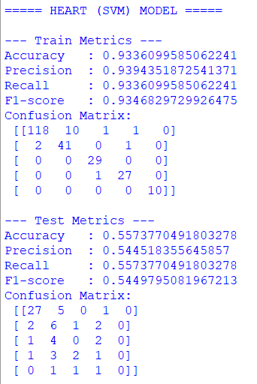
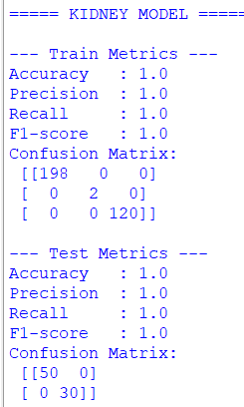

Slide 7
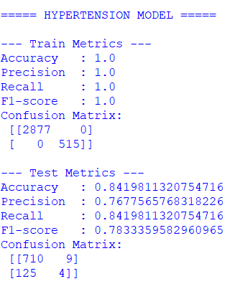
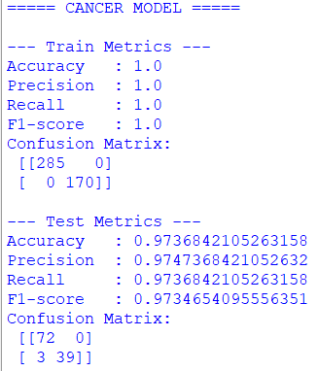
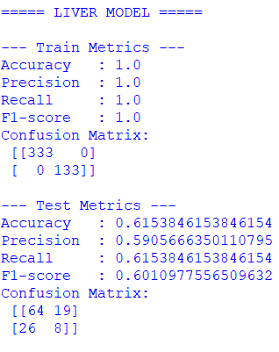

Slide 8
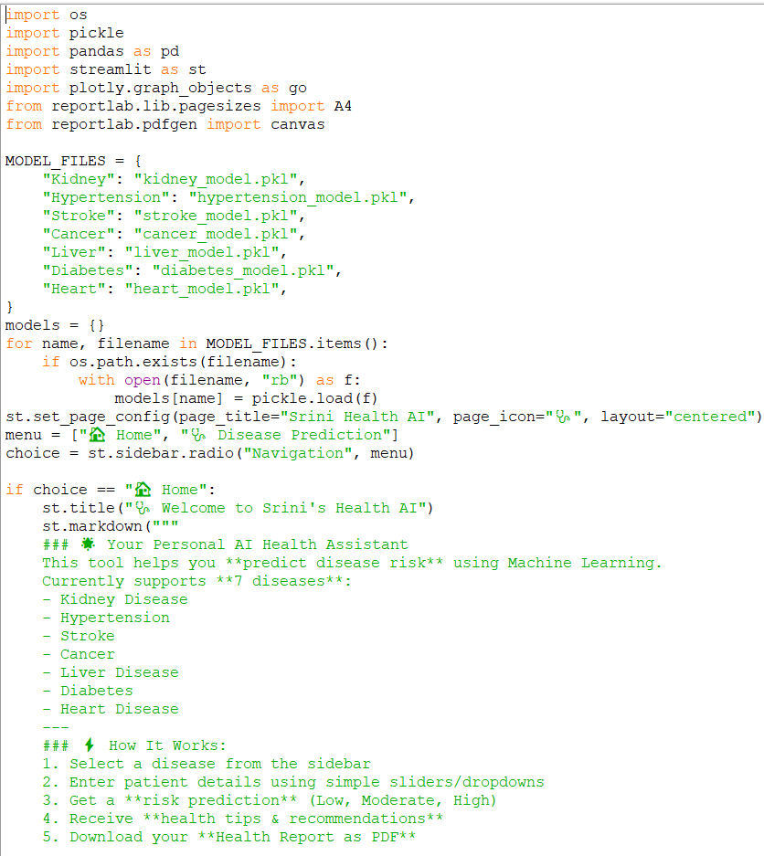
10

Slide 9
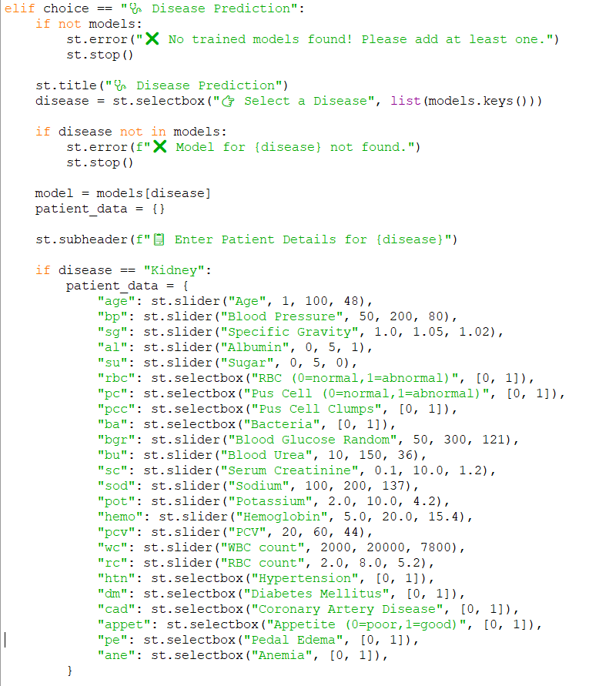

Slide 10
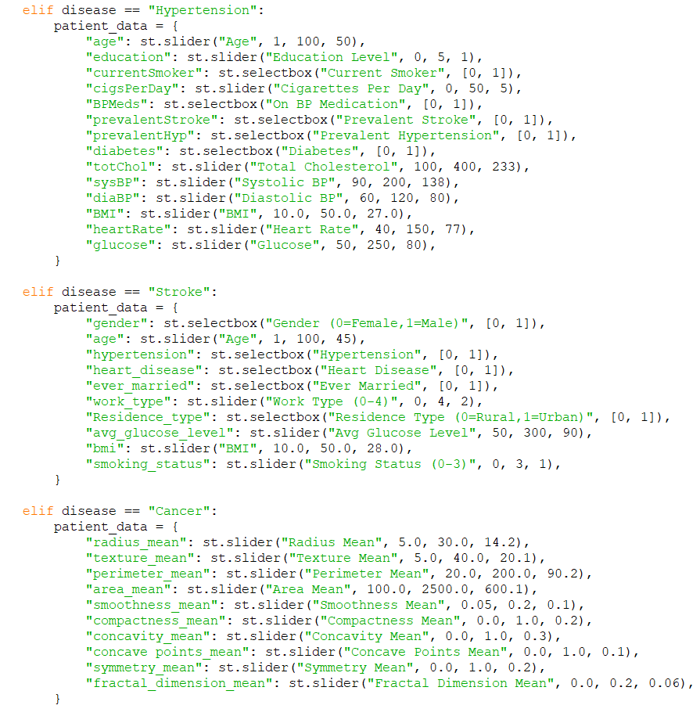

Slide 11
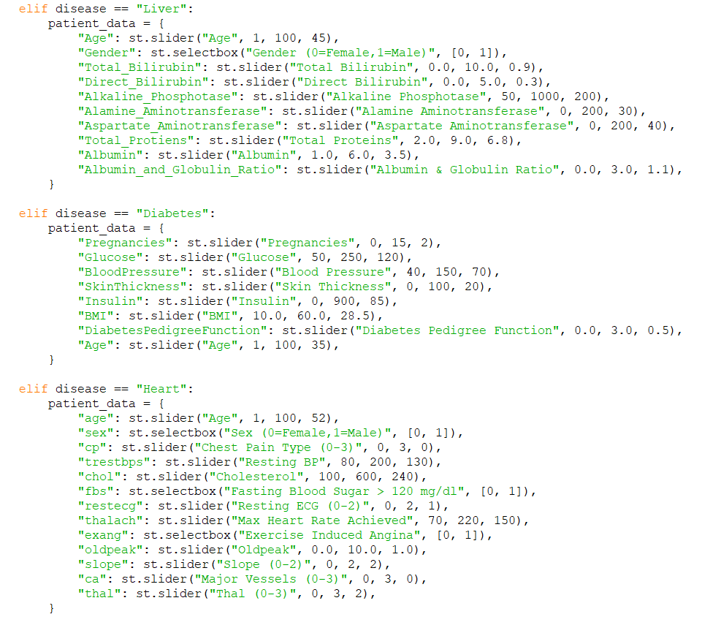

Slide 12
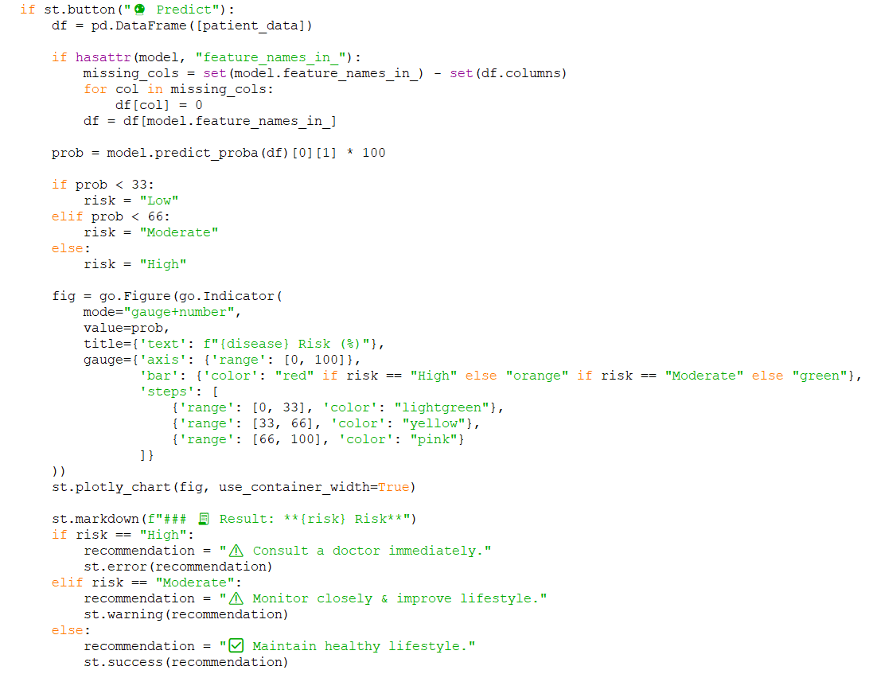

Slide 13
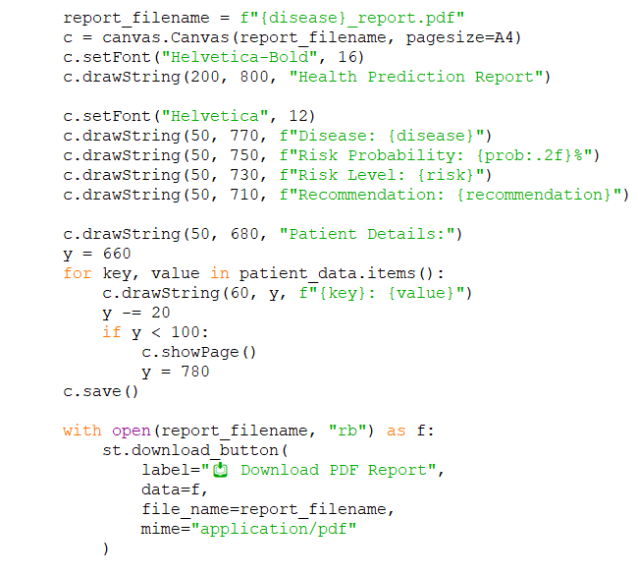
DEMO

Slide 14
EVALUATION
Developed & tested 7 disease-specific models (Kidney, Heart, Diabetes, Liver, Cancer, Stroke, Hypertension).
Unified evaluation using accuracy, precision, recall, F1-score & confusion matrices
High fidelity models: Kidney, Cancer, Stroke (≈95–100% accuracy).
Moderate performers: Diabetes, Hypertension (≈75–85%)
Challenging domains: Heart, Liver (≈55–65%), due to imbalanced datasets & overlapping symptoms.
Instead of relying on accuracy alone, we emphasized balanced metrics (Precision–Recall tradeoff).

Slide 15
INFERENCE
AI can predict multiple disease with good accuracy.
Shows AI is useful as a doctor ‘s assistant ,not a replacement.
With More Data ,accuracy will improve all disease

Slide 16
THANK YOU

